Slide 1
A Small Dose of Ethics
An Introduction to the Ethical, Legal and Social Issues that Toxicologist Confront
Steven G. Gilbert, PhD, DABT
www.toxipedia.org
www.asmalldoseof.org

Slide 2
Outline
An Introduction to Ethics
Evolution of Ethics
Causal Inferences
Basic Principles
Integrity
Animals in Research
Humans in Research
Resources

Slide 3
AN INTRODUCTION TO ETHICS

Slide 4
Ethical, Legal and Social Issues in Toxicology
In toxicology, intersection of science, ethics and legal issues is unavoidable
Toxicology research and other activities need to be conducted within societal context

Slide 5
Power To Discover The Truth
“It is not the truth that makes you free. It is your possession of the power to discover the truth. Our dilemma is that we do not know how to provide that power.”
Richard Lewontin
(New York Review of Books, Jan 7, 1997)

Slide 6
Human & Environmental Health
“Conditions that ensure that all living things have the best opportunity to reach and maintain their full genetic potential.”
S. Gilbert (1999)

Slide 7
Weighing Risk and Benefits
Need to look at issues from all sides, for example, use of pesticides and information on pesticides:
  Potential health effects (human and ecological) of pesticide use
  Use of animals in research
  Use of human subjects in research
  Risks of not having pesticides – malaria, West Nile virus

Slide 8
Ethics and Science
1860’s - Scientific method in medicine, Gregor Mendel
- Penicillin discovered – widely used WWII
1920’s - Lead in gasoline, lead in paint
- 30 states had sterilization laws on books
- Tuskegee syphilis study initiated
- Nuremberg - The Doctors Trial
- First open heart surgery & Chlorpromazine
- Structure of DNA – Watson & Crick

Slide 9
Ethics and Science
- First open heart surgery & Chlorpromazine
- Structure of DNA – Watson & Crick
1960’s - Thalidomide
Mercury
Chronic hemodialysis
Amniocentesis
Human Subjects
Informed consent, IRB’s, Helsinki Declaration adopted

Slide 10
Ethics and Science
70’s - Hastings Center founded, bioethics defined, Tuskegee noticed, Belmont Report (3 principles), Genentech Inc. founded, awareness of FAS, sensitivity of developing CNS
80’s - Recombinant microorganism could be patented, lead is harmful to developing brain
90’s - molecular biology, sequencing of human genome (other species), Jurassic Park
00’s - US stem cell research restricted
03 - Human cloned?

Slide 11
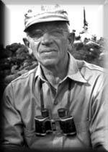
The First Bioethicist
Aldo Leopold
"A thing is right when it tends to preserve the integrity, stability, and beauty of the biotic community. It is wrong when it tends otherwise." - Aldo Leopold, 1949, A Sand County Almanac
---------- 1887 - 1948 ----------

Slide 12
Limits on Freedom
“An ethic, ecologically, is a limitation on freedom of action in the struggle for existence”
Aldo Leopold

Slide 13
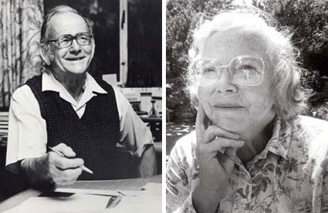

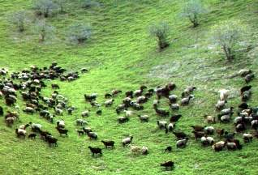
“The Commons”
The Tragedy of the Commons
By Garrett Hardin, Science, 1968

Slide 14
Technical Solutions
“It is our considered professional judgment that this dilemma has no technical solution.”
The Tragedy of the Commons
By Garrett Hardin, Science, 1968

Slide 15
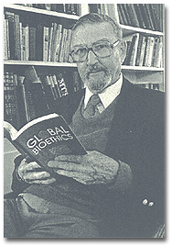
Bioethics
Van Rensselaer Potter
"Biology combined with diverse humanistic knowledge forging a science that sets a system of medical and environmental priorities for acceptable survival.“
Global Bioethics (1988)
-------- 1911 - 2001 --------

Slide 16
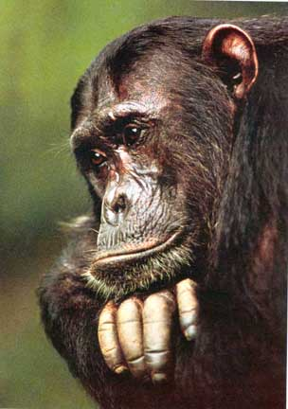
Decision Making – Causal Inferences

Slide 17
Sir Austin Bradford Hill
"All scientific work is incomplete - whether it be observational or experimental. All scientific work is liable to be upset or modified by advancing knowledge. That does not confer upon us a freedom to ignore the knowledge we already have or postpone the action that it appears to demand at a given time. "
Sir Austin Bradford Hill (1965)

Slide 18
Determining Causation
Strength of association
Consistency of findings
Biological gradient
Temporal sequence
Biologic or theoretical plausibility
Coherence with established knowledge
Specificity of association
Sir Austin Bradford Hill (1965)

Slide 19
Legal Implications
Often legal and financial implications:
  Agent Orange compensation
  Breast implants
  Other toxic torts

Slide 20
By academic freedom I understand the right to search for truth and to publish and teach what one holds to be true.
This right implies also a duty: one must not conceal any part of what one has recognized to be true.
Albert Einstein

Slide 21
BASIC PRINCIPLES

Slide 22
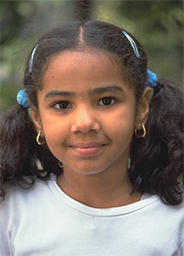
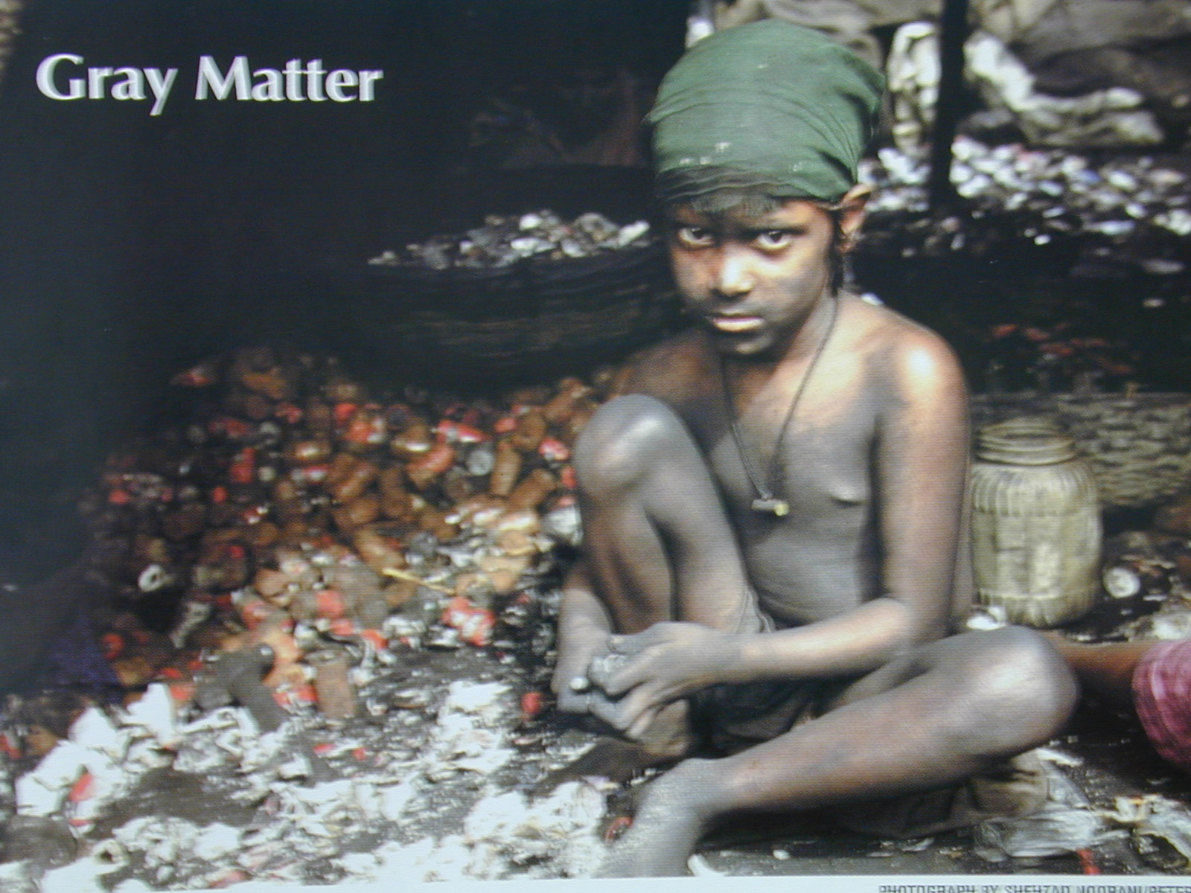
Basic Principles

Slide 23
Biomedical Ethics
Respect for Autonomy
Nonmaleficence
Beneficence
Justice
Beauchamp and Childress, 1994

Slide 24
Respect for Autonomy
B&C – a norm of respecting the decision making capacities of autonomous persons
  Support decisions of clients
  No right or wrong
  Optimal use of information
  Education
  Honesty – tell the facts
  (not truth, not right or wrong)

Slide 25
Non-maleficence
B&C – a norm of avoiding the causation of harm
  Do no harm (the Hippocratic Oath)
  Truth telling to avoid harm

Slide 26
Beneficence
B&C – a group of norms for providing benefits and balancing benefits against risks and cost
  Do good
  Golden rule of Christian tradition – do unto others

Slide 27
Justice
B&C – a group of norms for distributing benefits, risks and cost fairly
  Equal Access
  Right to medical care

Slide 28
Medical Ethics Evolution
1803 Thomas Percival – doctrine of medical ethics – basis for American Medical Association first code of ethics 1947
  That nonmaleficence and beneficence trump the patient’s (client’s) preference and rights in any circumstance of serious conflict
  Lack of respect of autonomy and distributed jutice

Slide 29
Today’s Medical Ethics Issues
Stem Cell Research
Cloning

Slide 30
Integrity

Slide 33
Animals in Research
Benefit to Humans versus Harm to Animals
Often a matter of individual believes
Notes:
SWINE MODEL
There are many reasons to use swine
Significant literature now available on swine as a model

Slide 34
Animals in Research
Animals Killed Annually in the U.S.
400 Million Motorists
200 Million Hunters
20 Million Dogs & Cats Abandoned
5 Billion Food
Livestock & Poultry
18 Million Rats & Mice
Research
2 Million Other Species
Research

Slide 35

REGULATORY DEMANDS
Animal Care –
AAALAC, USDA, NIH
GLP Compliant
OLAW Approved
Radioisotope License
Quality Assurance Manager

Slide 36
National Research Council
Guide for the Care and Use of Laboratory Animals
Institute of Laboratory Animal Resources
Outlines:
Institutional Policies and Responsibilities
Animal Environment, Housing, Management
Veterinary Medical Care
Physical Plant

Slide 37
Animal Welfare Act
Title 9 CFR Chapter 1, 1990 (1966, 1970, 1985)
Regulatory Authority ⎯ Animal and Plant Health Inspection Service of the United States Department of Agriculture (USDA)

Slide 38
NIH
Public Health Service Policy on Humane Care and Use of Laboratory Animals 1996
OLAW
Office for Laboratory Animal Welfare
National Institutes of Health
United States Public Health Service

Slide 39
AAALAC
Association for Assessment and Accreditation of Laboratory Animal Care International
Est. 1965

Slide 40
CDC
Centers for Disease Control and Prevention
Special Permit to Import Nonhuman Primates
Registration as Importer

Slide 41
Endangered Species Act
Endangered Species Act
Title 50 CFR
1973 (1969)
Regulatory Authority ⎯ Fish and Wildlife Service of the United States Department of Interior

Slide 42
CITES
Convention on the International Trade in Endangered Species of Wild Fauna and Flora (CITES)

Slide 43
Animal Transport
Regulations for Transport of Wild Mammals and Birds
Title 50 CFR
Regulatory Authority ⎯ Fish and Wildlife Service of the United States Department of Interior

Slide 44
International Air Transport
International Air Transport Association
Resolution 620
Live Animals Regulations
26th Ed., October, 1999
151 Signatory Countries

Slide 45
Humans in Research

Slide 46
Expanding the IRB
Traditional institutional review board (IRB) focus on protecting the rights and ensuring the safety of the individuals involved.
To address broader community concerns.
Propose the development of Environmental Health and Community Review Boards (EHCRBs)
Gilbert, SG. Supplementing the Traditional Institutional Review Board with an Environmental Health and Community Review Board. Environ Health Perspect 114:1626–1629 (2006).

Slide 47
Premise
Only by acknowledging the needs of and working with the community can we ensure ethically based and socially responsible research.

Slide 48
Traditional Ethical Foundation
Focus on the individual
  Respect for autonomy
  Beneficence
  Nonmaleficence
  Justice

Slide 49
Alternative Ethical Foundation
Expanded ethical construct
  Dignity
  Veracity
  Sustainability
  Justice
Emphasis on community.
[Gilbert, SG. EHP (2006)]

Slide 50
Community Based Participatory Research
Promotes active collaboration and participation
Fosters co-learning
Projects are community driven
Disseminates results in useful terms
Research and intervention strategies
are culturally appropriate
Defines community as a unit of identity
Build community capacity
[adapted from O’Fallon & Dearry (2002)]

Slide 51
Environmental Health & Community RB
(EHCRB)
Ethical responsibility to the community in which the project was taking place.
Dealing with ethical issues associated with broader community concerns & implications
  Community members
  Family members
  Neighborhood groups
  Local businesses

Slide 52
EHCRB
Dignity
Veracity
Sustainable
EHCRB
Justice
Foundation of IRB Principles &
Community Based Participatory Research
[Gilbert, SG. EHP (2006)]

Slide 53
EHCRB Responsibilities
Community and stakeholders
Consultation with the community
Implications for individuals and the community
Workplace-based projects

Slide 54
EHCRB membership and conduct
Include community members, scientists, and ethicists
Establish the board within a community, not within an institution
Hold meetings convenient for the community
Include roles and responsibilities of a current IRB
Expand role to include elements of dignity, veracity, sustainability, and justice.

Slide 55
EHCRB Conclusion
Only by defining and addressing the needs of the community can we ensure ethically based and socially responsible research.

Slide 56
Summary
Responsibility for activities and potential impacts: ethical, legal, social
Consider the good and bad consequences
Issues are complex
Evolution of what is acceptable
Lots of grey areas

Slide 57
Additional Resources
Beauchamp TL, Childress JF. 1994. Principles of Biomedical Ethics. 4th ed. New York:Oxford University Press.
Gilbert, SG. Supplementing the Traditional Institutional Review Board with an Environmental Health and Community Review Board. Environ Health Perspect 114:1626–1629 (2006).
Gilbert SG. 2005. Ethical, legal, and social issues: our children's future. Neurotoxicology 26(4):521–530.

Slide 58
Additional Resources
Environmental Protection Agency. 2005. Environmental Justice. http://www.epa.gov/compliance/environmentaljustice/
World Medical Association. 2004. Declaration of Helsinki Ethical Principles for Medical Research Involving Human Subjects. http://www.wma.net/e/policy/b3.htm
National Commission for the Protection of Human Subjects of Biomedical and Behavioral Research. 1978. The Belmont Report: Ethical Principles and Guidelines for the Protection of Human Subjects of Research. http://ohsr.od.nih.gov/guidelines/belmont.html

